Slide 1
RateMyProfessor Command Line Interface
By: Austin Trinh, David Le, Raymond Lin

Slide 2
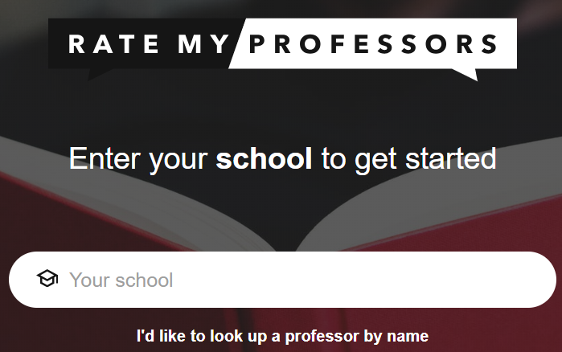
Problem
The RateMyProfessors Catalog only has search with Professor Name, School, and Department
Annoying to compare professors teaching the same course when searching one at a time
A student has to go through every professor to find one they like

Slide 3
Solution
Scrape data from both RateMyProfessors to provide search capability
Create CLI (Command Line Interface) with intuitive commands
Allow student to search a course up, and see professors who teach that course–then compare the ratings between the professors
User Interface to see results

Slide 4
Future Plans
Website and Database
Scrape from Course Catalog
Compatibility with other Schools (Plugins that scrape school data)
LLM Search based on Review Sentiment
Remove outdated information (professors that are no longer teaching a course)

Slide 5
Demo!

